Slide 1
Genetic Research
Research Compliance
Notes:
The ethics of genetic and genomic research have received a great deal of attention due to several factors. Genetic testing can reveal a strong predisposition to future disease, making the information psychologically powerful and raising concerns about stigma and discrimination.

Slide 2
Objectives
Definition of “Genetic research” and its complexity
Current regulatory status of genetic research
Human subject protection issues:
Risk and benefits
Consent for genetic research
Data and tissue storage
Gene transfer
HIPAA, privacy and genetic research

Slide 3
Definition(s)
Molecular genetics- Pertains to DNA/RNA
Passes from one generation to another, the hereditary material (familial)
Pedigree (no genetic testing is required)
Genetic testing:
DNA, chromosome, genes or gene product testing (i.e. variations, mutations)
nonDNA-based tests (i.e. sweat chloride determination to cystic fibrosis)

Slide 4
Genetic Tests Available
Research genetic testing – helps researches to learn more about how genes contribute to health and disease, as well as develop gene-based treatments. Sometimes the results do not directly help the research participant, but they may benefit others in the future by helping researchers expand their understanding of the human body.
Diagnostic testing - identifies a genetic condition or disease that is making or in the future will make a person ill. The results of diagnostic testing can help in treating and managing the disorder.
Predictive and pre-symptomatic genetic testing - finds genetic variations that increase a person’s chance of developing specific diseases. This type of genetic testing may help provide information about a person’s risk of developing a disease, and can help in decisions about lifestyle and health care.
Carrier testing–tells people if they “carry” a genetic change that can cause a disease. Carriers usually show no signs of the disorder; however, they can pass on the genetic variation to their children, who may develop the disorder or become carriers themselves.
Prenatal testing - is offered during pregnancy to help identify fetuses that have certain diseases.
Pre-implantation genetic testing –is done in conjunction with in vitro fertilization to determine if embryos for implantation carry genes that could cause disease.
Newborn screening - is used to test babies one or two days after birth to find out if they have certain diseases known to cause problems with health and development.
Pharmacogenetic testing - gives information about how certain medicines are processed in a person’s body. This type of testing can help a healthcare provider choose the medicines that work best with a person’s genetic makeup. For example, genetic testing is now available to guide treatments for certain cancers.

Slide 5
Privacy for Genetic Research
Related individuals share many of the same gene sequences in their DNA, meaning that genetic information about one individual provides information about another individual whom may or may not have consented to genetic testing. Genetic testing tends to pose informational risks, that is, risks that flow from potential breaches in privacy and confidentiality of genetic information. Information discovered by DNA can include:
Identification of individual(sex, ethnic background, forensics, paternity)
Genetic Disorders (Fragile X, Huntington’s Disease)
Genetic Predisposition (HPV, cancer)
Hereditary Traits that can be passed to offspring (Sickle Cell anemia & color blindness)
Genetic Research involving gene transfers or gene therapy remains in early stages of development. The risks associated with gene transfer studies allow more information to be identified and the uncertain nature of risks have slowed the development of research within this field.
Notes:
Many people consider genetic privacy and confidentiality more important than the privacy and confidentiality for other types of health information. This could be because of concerns over increased risk of genetic discrimination and stigmatization. For most genetic studies, the physical risk to individuals is minimal, often involving no more than a blood draw, cheek scrapping, or use of biological tissues obtained in the course of clinical care. However, far more insidious are the risks that are psychosocial or financial in nature. Historically, genetic concepts and information have sometimes been misused to effect social and political ends thus the reason for monitoring.

Slide 6
Genetic Information
Unlike most other kinds of health information, genetic information applies to or is about more than one person. When you analyze genomes you will learn presumptively about a person's parents, siblings, children, and others. This is because each of us shares 50 percent of our genetic information with each parent, sibling, and child.
Example : A research subject carries a BRCA1 mutation, we know that one of his or her biological parents is also a carrier of the BRCA1 mutation and that each of his or her children and siblings is at a 50 percent risk of being a mutation carrier.
So, knowledge about the genetic makeup of "blood relatives" is usually probabilistic in nature unless, of course, a blood relative is showing clinical signs of the disease in question. This means that the privacy and confidentiality of these individuals are at risk even if they are not the source of the specimen or of the information or the research topic.

Slide 7
Example : For Gene mapping or association studies, clarification of disease status through clinical evaluation or genetic testing as part of the research may result in some individuals being diagnosed with the disease found to be at a significantly increased risk of developing the disease. To some, this information construes a risk in that it is unexpected and undesired. To other individuals, however, this may represent a benefit because it may lead to early treatment, preventive care and knowledge about future risk to the subjects and their families.
In this case, the study protocol should include some provision for referral to genetic counseling and clinical management services should a subject receive a previously unknown diagnosis. The possibility of false-positive and false-negative results in making the diagnosis may also need to be addressed.

Slide 8
Example : A subject who is the only patient ever to be diagnosed with a certain disease at a medical center will usually be known by virtue of his or her diagnosis. Thus, even “anonymous” study records on a subject with this rare diagnosis may actually be identifying information. In family studies, the specific pattern of different kinds or relatives in a pedigree drawing may betray the identity of an individual, especially when linked to the disease being studied. This is common in genetic mapping pedigree studies involving large pedigrees.
Sometimes, genetic testing results of one individual may lead one to draw certain conclusions about the results for another individual. There can be significant coercion concerning participation in a study and sharing of testing results in an extended family. Investigators and reviewers of the protocol need to be aware and have a sensitivity to these issues. In addition, the complex and sometimes unpredictable relationships amongst family members makes it important to protect again disclosure of genetic information through legal proceeding.
*Certificates of Confidentiality*
For studies in which identifiable, sensitive information is being accessed (HIV status, history of alcoholism, mental illness, etc.), the investigator may obtain protection from subpoena of his/her records by receiving a study specific Certificate of Confidentiality from the NIH.
Notes:
For more information, visit: Certificates of Confidentiality Kiosk.

Slide 9
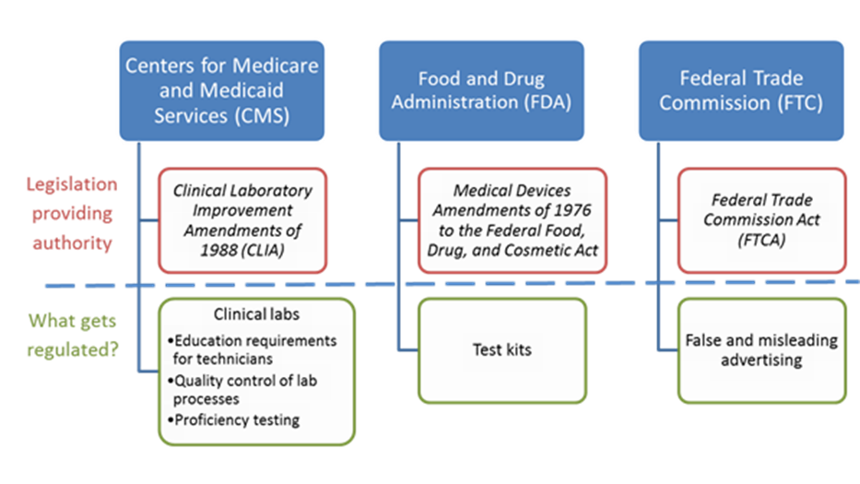
Federal Regulations of Genetic Tests
Three federal agencies play a role in the regulation of genetic tests: CMS, FDA, and the Federal Trade Commission (FTC).
https://www.genome.gov/10002335/regulation-of-genetic-tests/
Genetic Information Nondiscrimination Act (GINA), which became law in 2008. The Final Rule, effective 2013, provided implementation of GINA.
DHHS includes “genetic information” as a type of health information subject to HIPAA rules, provides national protections against discrimination for health insurance and employment purposes based on genetic test results. Some states offer additional protections for health care consumers that undergo genetic testing.

Slide 10
Genetic Testing: CMS
CMS is responsible for regulating all clinical laboratories performing genetic testing, ensuring their compliance with the Clinical Laboratory Improvement Amendments of 1988 (CLIA). The objective of CLIA is to certify the clinical testing quality, including verification of the procedures used and the qualifications of the technicians processing the tests.
Notes:
The Clinical Laboratory Improvement Amendments Act of 1988 (CLIA) was enacted to help improve the quality of laboratory practices.
This type of research requires special attention to privacy and confidentiality, the role and scope of the valid consent process, and the appropriate approach to and process for the secondary use of data and stored biological samples.

Slide 11
Genetic Testing : FDA
Congress granted FDA the authority to oversee the use of medical devices in clinical research in the same 1976 Medical Device Amendments as authorized their premarket review of commercially marketed devices.
The degree of FDA oversight of a genetic test is based on its intended use and the risks posed by an inaccurate test result. The FDA categorizes medical devices, including genetic tests, into three separate classes, ranging from class I, for relatively low risk products, to class III, where tests are subject to the greatest level of scrutiny.
With genome, exome, and targeted panels from advanced sequencing platforms now being tested in clinical settings, some studies involving these technologies will require an Investigational Device Exemptions (IDE) from the FDA before enrolling participants. The IDE-similar to the Investigational New Drug application (IND) - is designed to ensure that there is appropriate oversight of the research use of new medical devices that have not been cleared or approved by FDA. It requires investigators to provide FDA with information on the device being used in the study, including the analytic validity for the researchers' intended use (i.e., whether the test measures what the researchers believe it measures).
Notes:
The FDA has the broadest authority in terms of regulating the safety and effectiveness of genetic tests as medical devices under the Federal Food, Drug, and Cosmetic Act.

Slide 12
Genetic Testing Federal Trade Commission Act (FTCA)
The FTCA- prevents false advertisements for foods, drugs, devices, and services prohibited (15 U.S.C. 54)
Includes marketers of genetic tests and Ad Claims
Prevents unfair or deceptive acts or practices
FTC-FDA Liaison Agreement
Since 1954, agencies have operated under a formal agreement which provides that:
FTC has primary jurisdiction for the advertising of foods (including supplements), OTC drugs, devices and cosmetics;
FDA has primary jurisdiction for the labeling of the products and for both advertising and labeling of prescription drugs by manufacturers
Notes:
15 U.S.C 54- Title 15 of the United States Code - False advertisements; Penalties
False Advertisement: an advertisement is
false if it is misleading in any material
respect (taking into account not only
representations made, but also the extent to
which the advertisement fails to reveal facts
material in the light of such representations
or material with respect to consequences
which may result from the use of the
product or service).

Slide 13
Genetic Testing: NIH
NIH: Beginning on 1/25/2015, studies proposing to use genomic data from cell lines or clinical specimens that were created or collected after this date, the NIH expects that informed consent for future research use and broad data sharing will be obtained even for cell lines or specimens that are de-identified. If there are compelling scientific reasons to use data or specimens collected after this date that do not have such consent, exceptions can be made (NIH 2014).
NIH Policy: Institutional Certification When Submitting Data (NIH 2014) - The Institutional Certification should state whether the data will be submitted to an unrestricted- or controlled-access database. For submissions to controlled access and, as appropriate for unrestricted access, the Institutional Certification should assure that:
The data submission is consistent, as appropriate, with applicable national, tribal, and state laws and regulations as well as relevant institutional policies;
Any limitations on the research use of the data, as expressed in the informed consent documents, are delineated;
The identities of research participants will not be disclosed to NIH-designated data repositories; and
An IRB, privacy board, and/or equivalent body, as applicable, has reviewed the investigator's proposal for data submission and assures that:
The protocol for the collection of genomic and phenotypic data is consistent with 45 CFR Part 46;
Data submission and subsequent data sharing for research purposes are consistent with the informed consent of the study participants from whom the data were obtained;
Consideration was given to risks to individual participants and their families associated with the data submitted to NIH-designated data repositories and subsequent sharing;
To the extent relevant and possible, consideration was given to risks to groups or populations associated with submitting data to NIH-designated data repositories and subsequent sharing; and
The investigator's plan for de-identifying datasets is consistent with the standards outlined in the NIH Genetic Data Sharing Policy
Certificates of Confidentiality
For studies in which identifiable, sensitive information is being accessed (HIV status, history of alcoholism, mental illness, etc.), the investigator may obtain protection from subpoena of his/her records by receiving a study specific Certificate of Confidentiality from the NIH.
Notes:
Large Scale genomic studies funded by the National Institute of Health (NIH) must now de-identify and upload all data to central databases; these studies are complex, difficult, and expensive. Therefore, data sharing allows researchers to make maximum use of the information generated (NIH 2014)
The Genomic Data Sharing (GDS) Policy applies to all NIH-funded research that generates large-scale human or non-human genomic data as well as the use of these data for subsequent research.
45 CFR Part 46-Code of Federal Regulations
TITLE 45
PUBLIC WELFARE
DEPARTMENT OF HEALTH AND HUMAN SERVICES
PART 46
PROTECTION OF HUMAN SUBJECTS
***
Revised January 15, 2009
Effective July 14, 2009

Slide 14
Genetic Protocol
Try to determine if genetic testing is part of the study, if necessary
The IRB receives and reviews the relevant information to evaluate the research studies (AAHRRP Element II.2.D)
Determine whether or not the information is necessary to achieve study goal
Risks to subjects are minimized (45 CFR 46.111 (a)(1))
Ensure proper safeguards are in place to protect information.
Research protocol makes adequate provisions for monitoring the data collection to ensure subject safety (45 CFR 46.111(a)(6)
Check for GINA language in consent: “…A Federal law, the Genetic Information Nondiscrimination Act of 2008 (GINA), generally makes it illegal…to discriminate against you based on your genetic information.
No informed consent may include… exculpatory language (45 CFR 46.116)
Ensure the subject is adequately informed about what will happen to their samples/data
Will samples/data be used for future research?

Slide 15
Any Questions?
If you have any questions please feel free to contact myself, Tiffany Mince, Assistant Director of Research Compliance at Tiffany.Mince@uhs-sa.com or call me at (210)743-6453.
In addition, you may call the anonymous integrity hotline available 24 hours a day, 7 days a week, with any questions or concerns about HIPAA requirements or regulations; or to report a HIPAA violation.
Notes:
University Health System is committed to protecting patient privacy and complying with HIPAA laws. When a staff member (discloses) provides a patient with another patient’s personal health information (PHI), the error is a wrongful disclosure. The Health System is required by HIPAA laws to mitigate, the risk of any harmful effects of the error. Harmful effects could result in a breach of PHI or even identify theft.

Slide 16
Resources
FDA Classifications for Medical Devices
NIH-DOE Task Force on Genetic Testing
www.ghr.nlm.nih.gov/handbook/testing
Holtzman, NA.; Watson, MS., editors
"Genetic Testing: How it is Used for Healthcare.“
NIH Genomic Data Sharing Policy
Genetic Information Nondiscrimination Act (GINA) of 2008
Certificates of Confidentiality Kiosk.
factsheet
https://www.genome.gov/10002335/regulation-of-genetic-tests/
https://www.genome.gov/27561291/points-to-consider-in-assessing-when-an-investigational-device-exemption-ide-might-be-needed/

